Slide 1

Name: Yuling Hsu
Major: Management Information System
Language: Programming Python
Employment 2014 Analysis
Notes:
Hi, everyone, I am going to introduce the models that I use to see the correlation that will highly affect employment rate.

Slide 2

Abstract
Employment rate influences by economic, employment rate differences in different countries or different industry fields. This could be influence by different source. I analyze the data in 2014, which is the latest data in world dataset.
Notes:
Unemployment rate influences people a lot, most of people are affected by many reasons that will lose jobs, I will analze the unemployment rate in 2014 to see how can we to predict unemployment rate in the future.

Slide 3

Unemployment Rate
🗹 Unemployment in countries like Spain North Macedonia, Greece, South Africa, Croatia are so the top unemployment rate in world dataset. Almost 50% of unemployment.
🗹 Germany, Norway, Switzerland, Iceland. Their unemployment rate are the lowest in 2014.
Notes:
For a general picture of the unemployment rate right now. North Europe countries like Germany, iceland have lowest unemployment rate. In contract, Africa and south europe, they have high unemployment rate in 2014.I want to know more about what will influence unemployment rate and why norway or germany they can keep the low unemployment rate.

Slide 4
Data
Preparation
Agriculture
Service
Industry
Unemployment
Rate
According to the clothest result to unemployment rate(2014) reasons and see about employment rate in different fields
Wage and salaried workers
Primary Education
Notes:
I conclude the most popular five common indexes that might affect the unemployment rate. They are Agricure, service, industry, wage and salaries of workers and primary education.

Slide 5
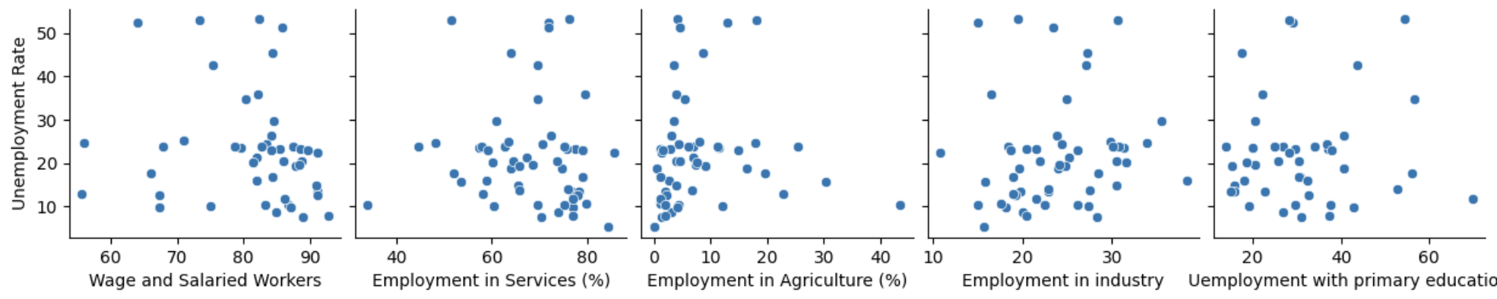
Correlation OUTLOOK
Only Agriculture has slight correlation.
Notes:
We will have a common stereotype that wage and primary influence unemployment rate. However, it’s not ture/ In 2014, the data shows not obvious relation between unemployment rate and other indexes, but we can see the agriculture seems has a trend. We have to confirm by model and visualization to see if my assumption is true or not.

Slide 6
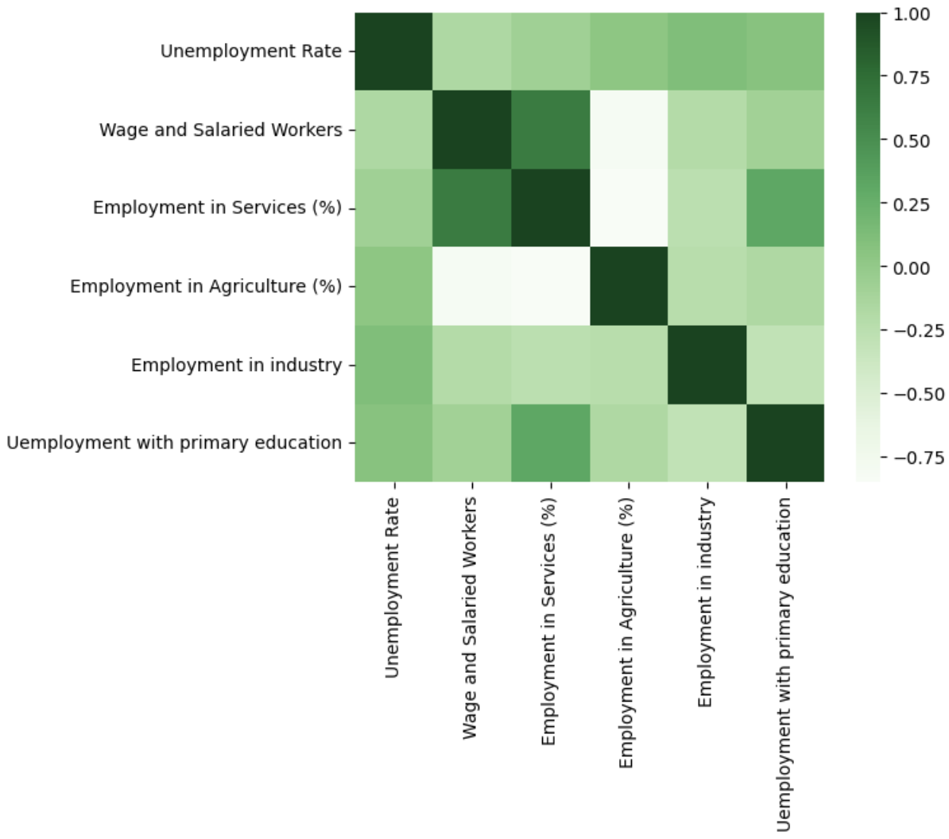
Data
Preparation
Agriculture
Service
Unemployment
Rate
Industry
According to the clothest result to unemployment rate(2014) reasons and see about employment rate in different fields
Wage and salaried workers
Notes:
Salaries and wage and people work in service fields have highly correlation between them. Agriculture and wage and people who work in service field, they have highly negative correlation, which means if people who work in agriculture more their salaries are less.

Slide 7
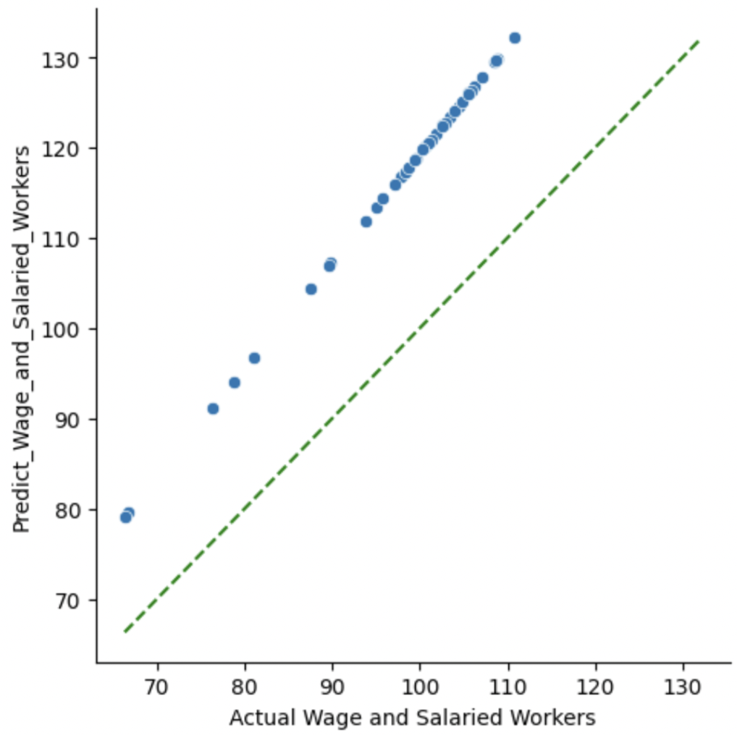
Wage and Salaried workers
CHANNELS
Social Media
Influencers
Tech Blogs
Notes:
I use linear regression to predict the results, yet the result seems related. However, compared with the perfect prediction, the result seems not around perfect prediction, which means the model is not quite precision. The result of prediction of wage and salaried workers and actual data is slightly different since its not around the perfect line of 45 angles.

Slide 8
Mean Error (ME) : 58.6152
Root Mean Squared Error (RMSE) : 59.9055
Mean Absolute Error (MAE) : 58.6152
Mean Percentage Error (MPE) : 70.4367
Mean Absolute Percentage Error (MAPE) : 70.4367
CHANNELS
Social Media
Influencers
Tech Blogs
Notes:
The regression statistics reveal key insights into the model's performance. The Mean Error (ME) of 58.6152 indicates that, on average, predictions deviate by approximately 58.62 units from actual values. The Root Mean Squared Error (RMSE) at 59.9055 provides a measure of the overall magnitude of errors, suggesting a moderate level of deviation between predicted and actual values. The Mean Absolute Error (MAE) echoes the ME at 58.6152, signifying the average absolute error between predicted and actual values. Meanwhile, the Mean Percentage Error (MPE) of 70.4367 indicates an average overestimation of around 70.44%, suggesting a consistent tendency to overpredict. This trend is further emphasized by the Mean Absolute Percentage Error (MAPE) at 70.4367. In conclusion, the model exhibits a noticeable level of prediction error, particularly in terms of overestimation, and it is crucial to consider these metrics in the context of specific use cases and acceptable error thresholds.

Slide 9
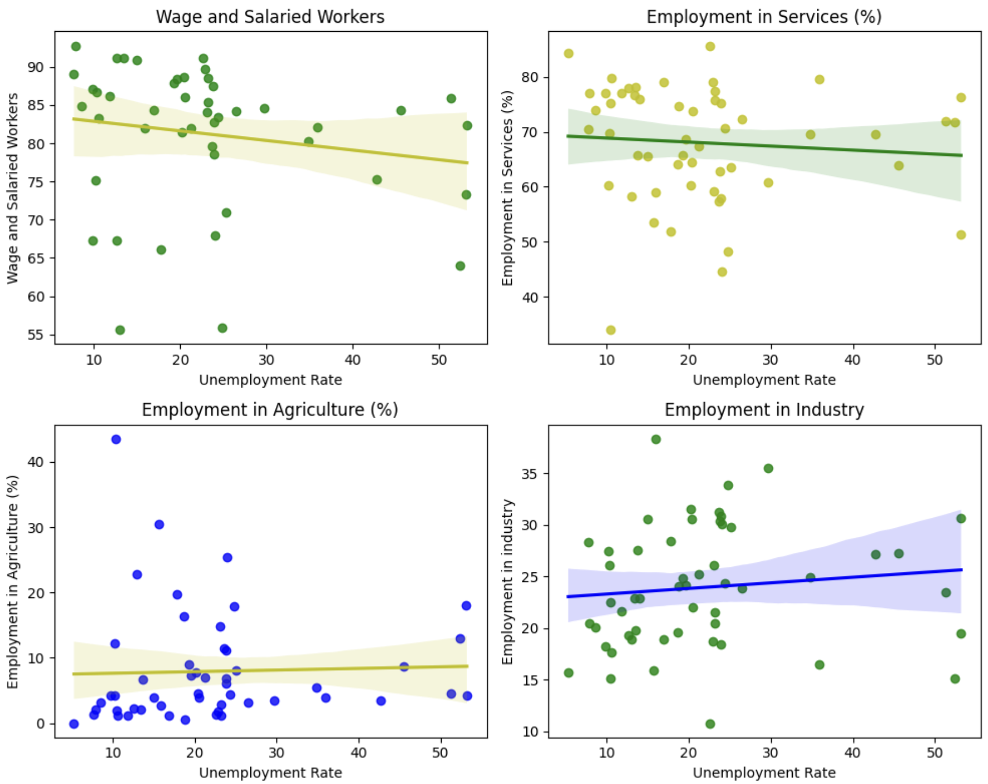
Linear Regression
Order: 1
y: Unemployment Rate
X:
Wage and Salaried Workers Employment in Services
Employment in Agriculture
Employment in industry
I think Linear regression can’t show relationship between variables
Notes:
Back to my core topic to use model to predict the unemployment rate by other factors like employment in service and agriculture and industry, I don’t think linear regression can show the trend.

Slide 10
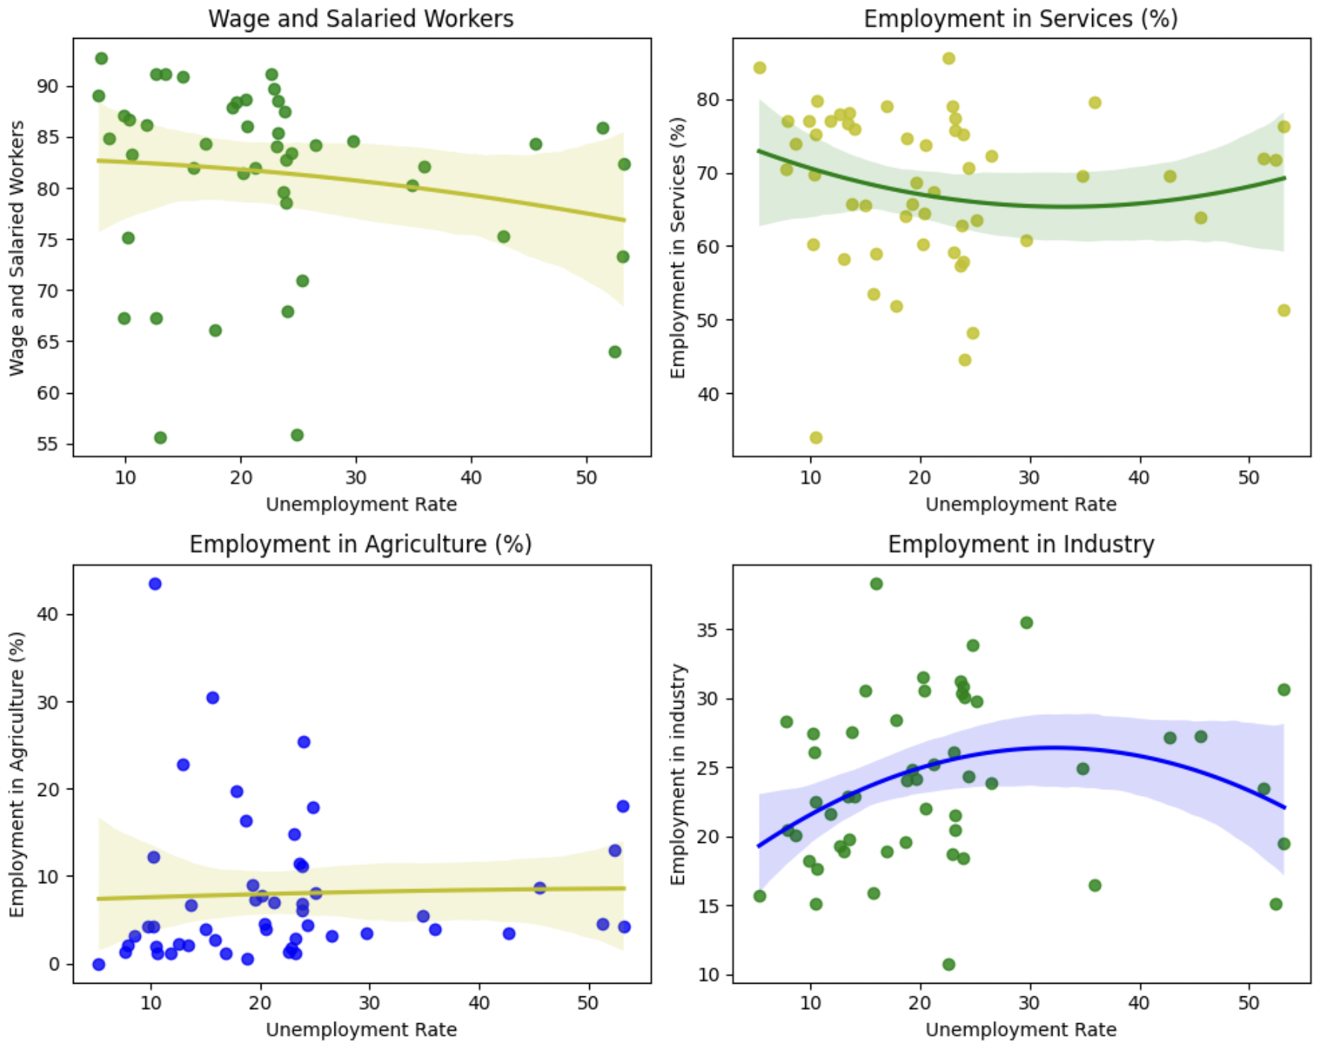
Quadratic Regression Order: 2
We can see there are some curves in order 2 chart. Quadratic regression looks better than linear regression.
Notes:
As I don’t think linear regression can perfectly present the correlation between factors with unemployment. In my opinion, quadratic regression looks better than linear regression. The line is curve and shows close to the data. I think I can also try cubic regression.

Slide 11
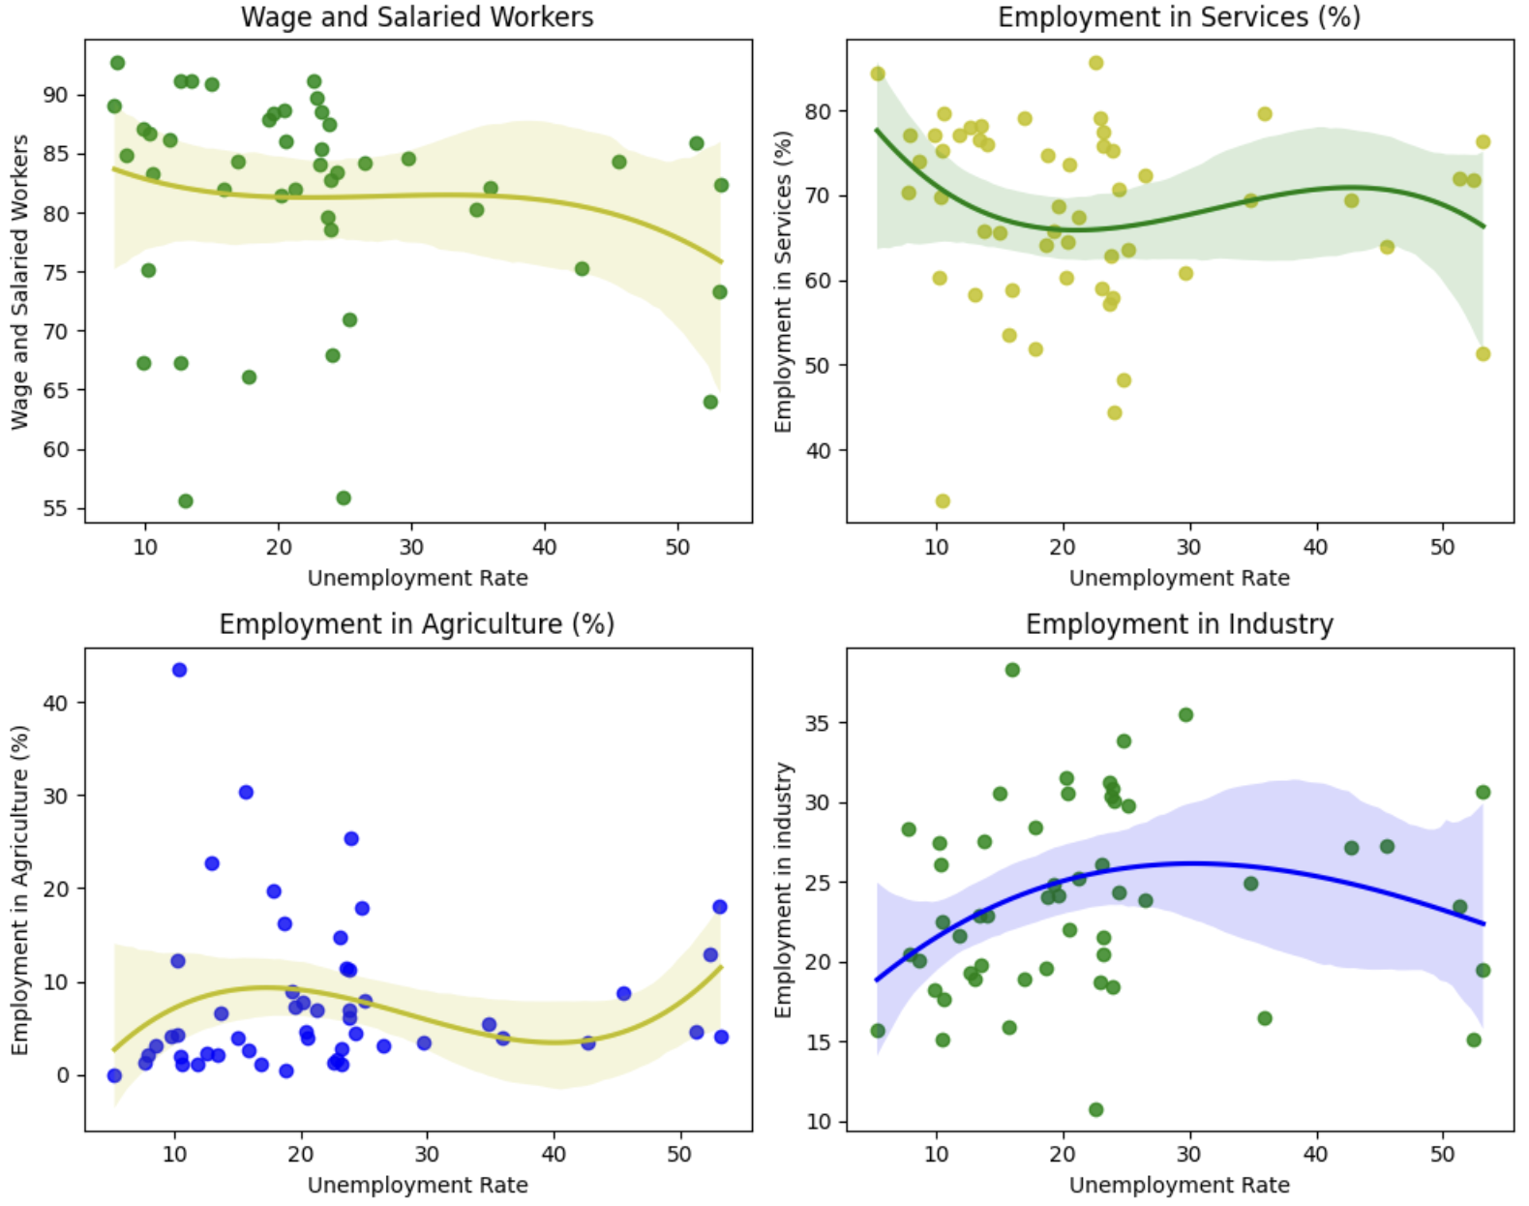
Cubic Regression Order: 3
We can see the lines in charts much fitter to the dots. However, I find it’s overfitting. For example, wage and salaries workers, this is not a curve. It influences by the dots or noise. This isn’t a trend.
Notes:
Cubic seems really close to the data. When I think Cubic regression is the best models. I find an issue. Overfitting problem, which is really common when training models. You see the in the line in the end of every chart are easy to influence by few data. I don’t think this can be a good models to predict.

Slide 12
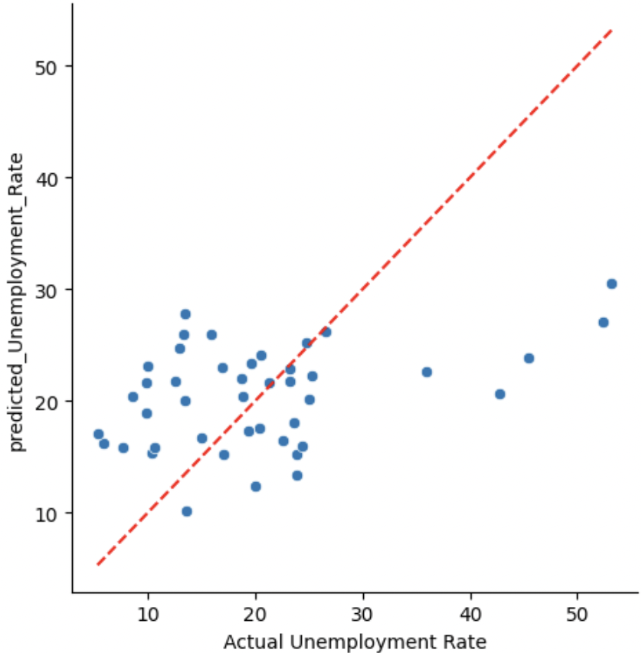
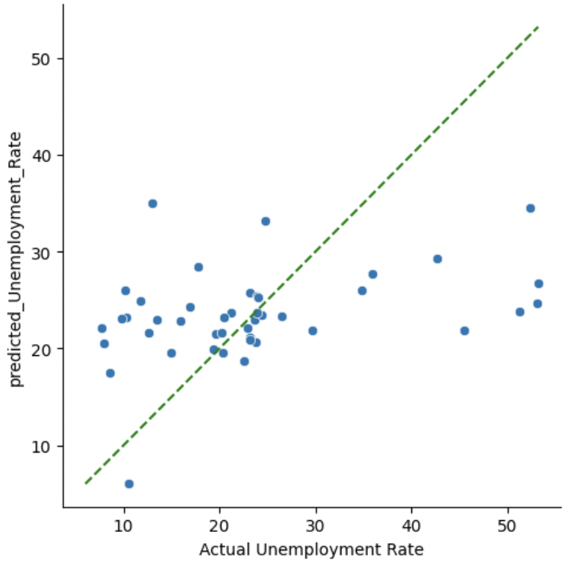
RMSE: 10.168
Prediction
Regression statistics
Mean Error (ME) : 0.0000
Root Mean Squared Error (RMSE) : 10.1688
Mean Absolute Error (MAE) : 7.9956
Mean Percentage Error (MPE) : -26.6034
Mean Absolute Percentage Error (MAPE) : 51.3033
Notes:
The evaluation metrics you provided for regression statistics give insights into the performance of the model:
The model's metrics show a positive overall performance. With a Mean Error (ME) close to zero, it indicates that, on average, the model's predictions are quite accurate. The Root Mean Squared Error (RMSE) at 10.1688 suggests a moderate level of error, and the Mean Absolute Error (MAE) stands at a favorable 7.9956, indicating good accuracy. Despite a Mean Percentage Error (MPE) showing an average overestimation of -26.6034%, the actual magnitude of this error is crucial for understanding. The Mean Absolute Percentage Error (MAPE) is at 51.3033, pointing to a reasonable level of accuracy. In conclusion, the model seems to be performing well, but whether it's deemed "good" depends on the specific context and acceptable error levels for the given application. To make a more informed judgment, it's recommended to compare these metrics with baselines or alternative models and carefully consider the practical implications of the observed errors in the specific use case.

Slide 13
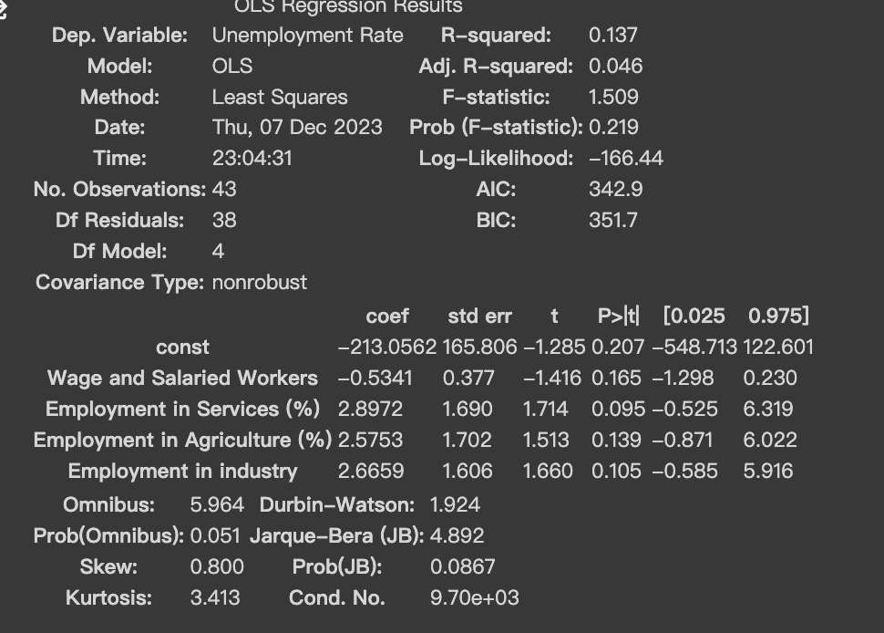
Notes:
The Ordinary Least Squares (OLS) regression model, aiming to predict the Unemployment Rate based on various independent variables, yields a mixed evaluation. The R-squared value of 0.137 indicates that approximately 13.7% of the variability in the Unemployment Rate is explained by the model, suggesting a modest explanatory power. However, the Adjusted R-squared of 0.046, along with the p-value associated with the F-statistic (0.219), suggests that the overall significance of the model is questionable. Individual coefficients for predictor variables lack consistent statistical significance, as indicated by their respective p-values. Additionally, diagnostic tests reveal potential issues such as skewness and kurtosis. Further scrutiny of the model, potential multicollinearity, and consideration of alternative specifications may be necessary for a more robust understanding and improvement of the model's predictive capacity.

Slide 14

Conclusion
Notes:
In conclusion, i don’t think any models can explain relationship with unemployment rate. `It's important to consider the specific context of the problem and compare these metrics to the scale of the predicted variable to determine the practical significance of these errors. Additionally, further analysis may be needed to understand the sources of these errors and explore potential improvements to the model.

Slide 15

THANK YOU
YUH162@pitt.edu
Data Source: worlddate.scv
Pictures Source: https://www.pexels.com/search/working/
Slide Source: COPYRIGHT © TEMPLATE.NET

Slide 16
MARKETING STRATEGY
CHANNELS
Social Media
Influencers
Tech Blogs
Upcoming "Future in Your Hands" campaign

